Slide 1
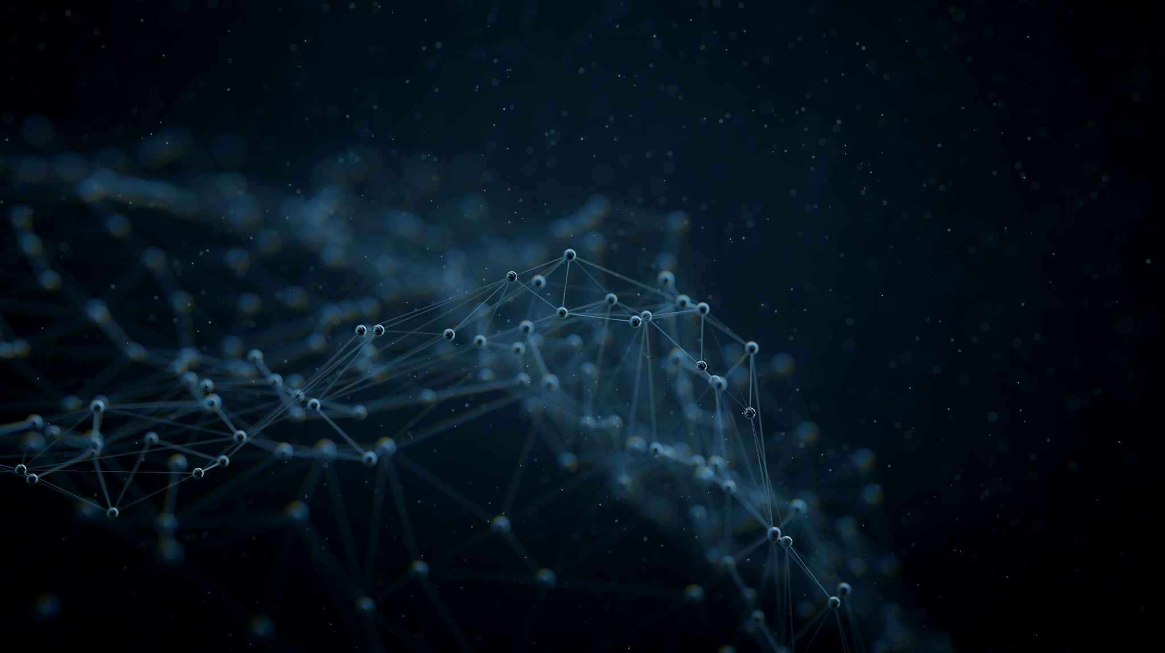
A Journey from peas to AI
How modern biologists see the world

Slide 2
Short Bio
PhD student at CIBIO-InBIO
Herlander Azevedo (PlantBio, Porto), Miguel Carneiro (EvolGen, Porto) and Tom Gilbert (Globe Institute, Copenhagen)
Background in Pharmaceutical Sciences and Biotechnology
Research Interests: Genomics and Metagenomics, Plants, Bioinformatics

Slide 3
What is bioinformatics?
Biology
Computer Science
Math / Statistics / Probability

Slide 4
What is bioinformatics?
OMICs
Genomics
Transcriptomic
Phenomics
Metabolomics
Proteomics
Epigenomics

Slide 5
What is bioinformatics?
OMICs
Genomics
Transcriptomic
Phenomics
Metabolomics
Proteomics
Epigenomics
Extract
valuable insights
with
biological validation
Integrate with computational and mathematical models

Slide 6
What is bioinformatics?
Process and analyse large-scale Raw Data
QC and transform / process Data
Apply Statistical Models and / or ML algorithms
Dimension reduction and / or Clustering
Data Visualization
Repeat and / or take different approach
Maker reports / presentations
Create Data driven Story

Slide 7
What is bioinformatics?
Adapt to new technologies, file formats,
statistical models or ML algorithms
Process and analyse large-scale Raw Data
QC and transform / process Data
Apply Statistical Models and / or ML algorithms
Dimension reduction and / or Clustering
Data Visualization
Repeat and / or take different approach
Maker reports / presentations
Create Data driven Story

Slide 8
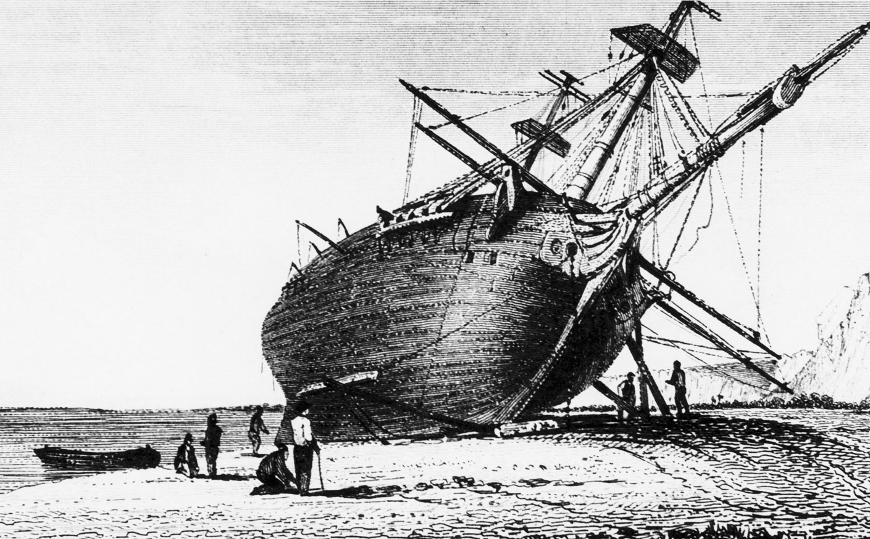
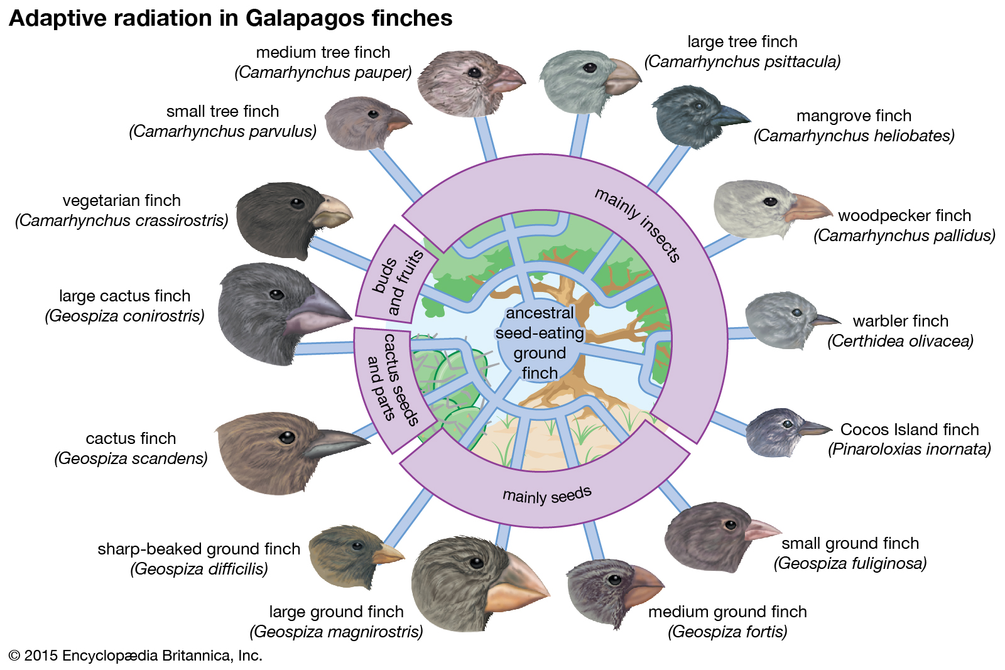
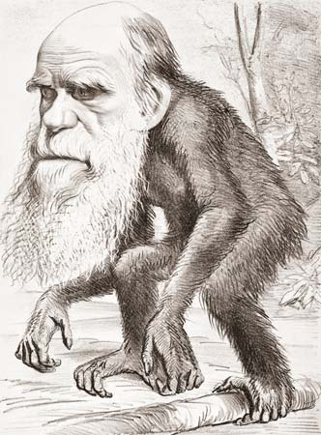
The voyage of the beagle
A journey that changed the world
Charles Darwin
1831-36
Hypothesis of evolution of species 1845

Slide 9
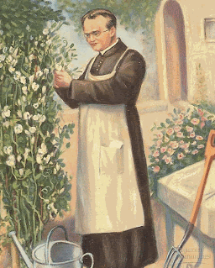
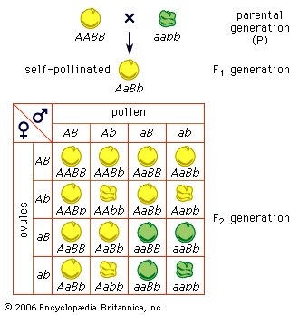
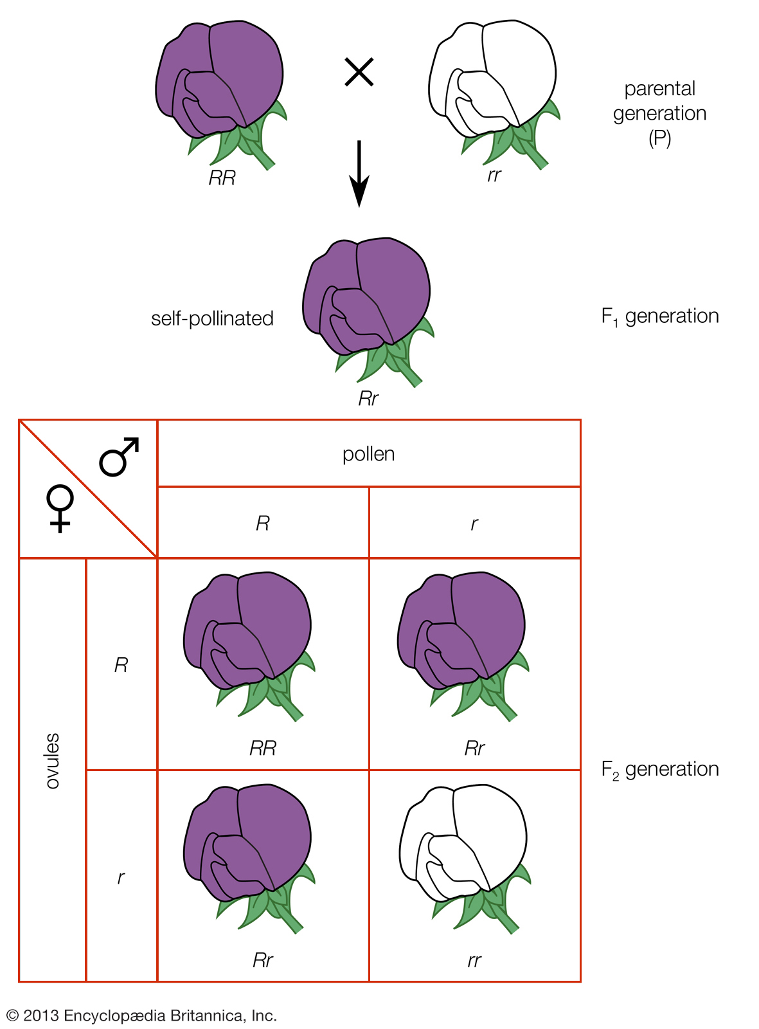
How a priest changed the world?
Gregor Mendel
1860’s
DeVries, Correns and
Tschermak
Early 20th century

Slide 10
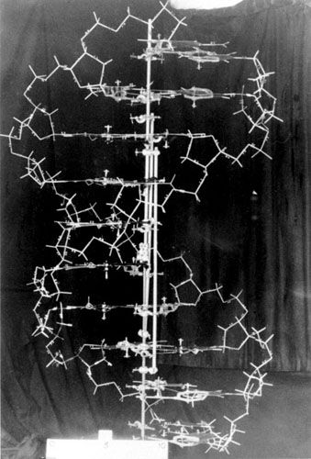
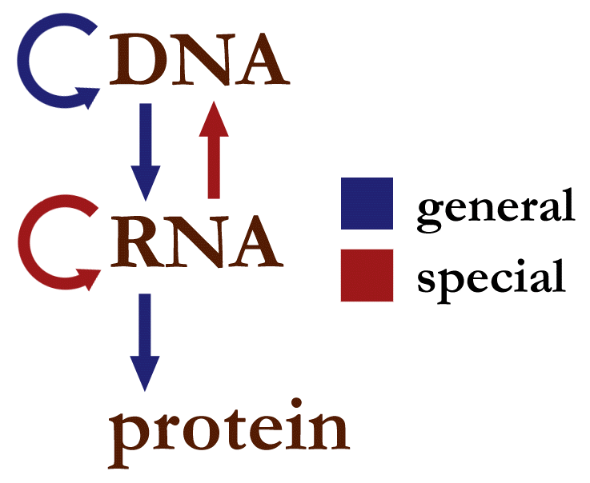
DNA – the building blocks of life
Watson, Crick and Franklin
1950’s
Structure of DNA
Central Dogma in molecular biology

Slide 11
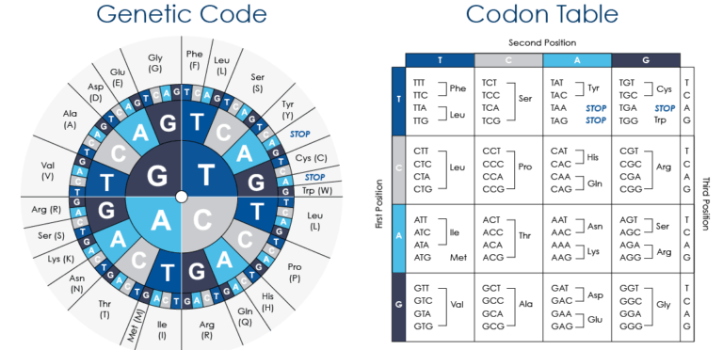
DNA – the building blocks of life
Watson, Crick and Franklin
1950’s
Khorana, Holley, Nirenberg decipher the genetic code.
These findings represent the birth of molecular biology.
1957

Slide 12
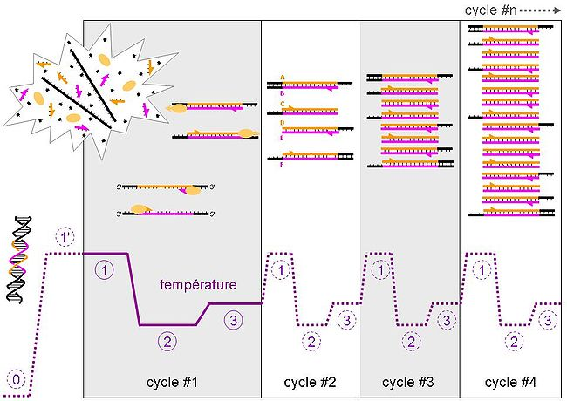
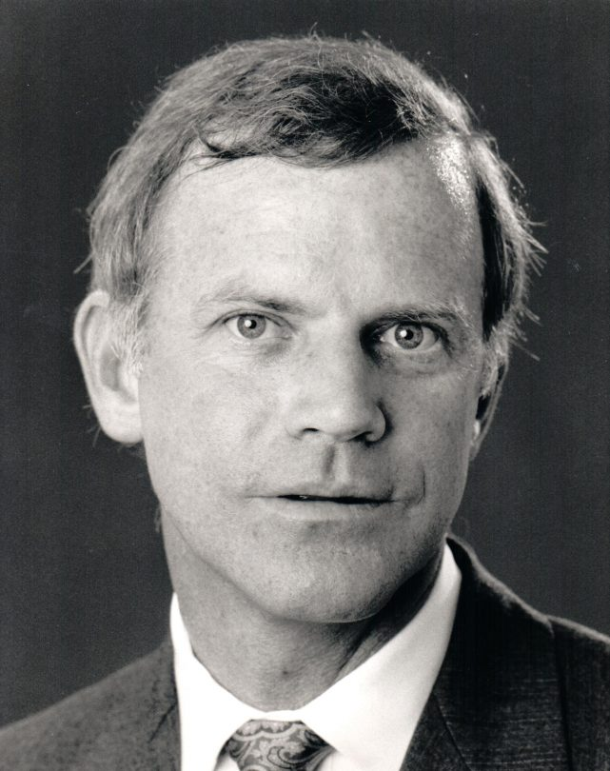
Playing with Legos
From DNA molecule to Genomics and Beyond
Polymerase chain reaction (PCR)
Kary Mullis

Slide 13
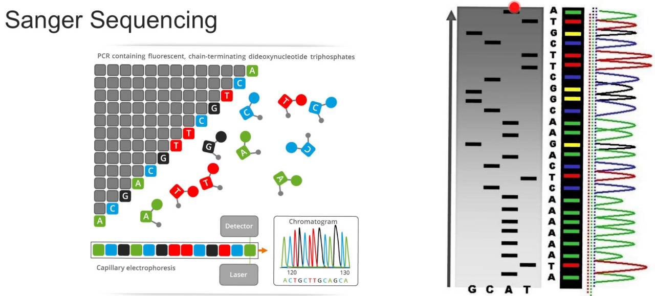
How to extract valuable insights?
Analyse structures
Sequences, properties and patterns.
Label data requires long and in-depth studies

Slide 14
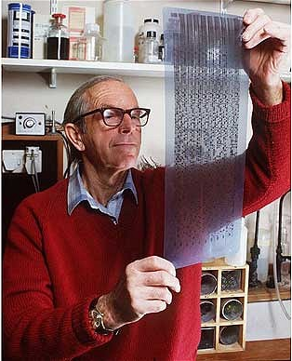
How to extract valuable insights?
Analyse structures
Sequences, properties and patterns.
Label data requires long and in-depth studies

Slide 15
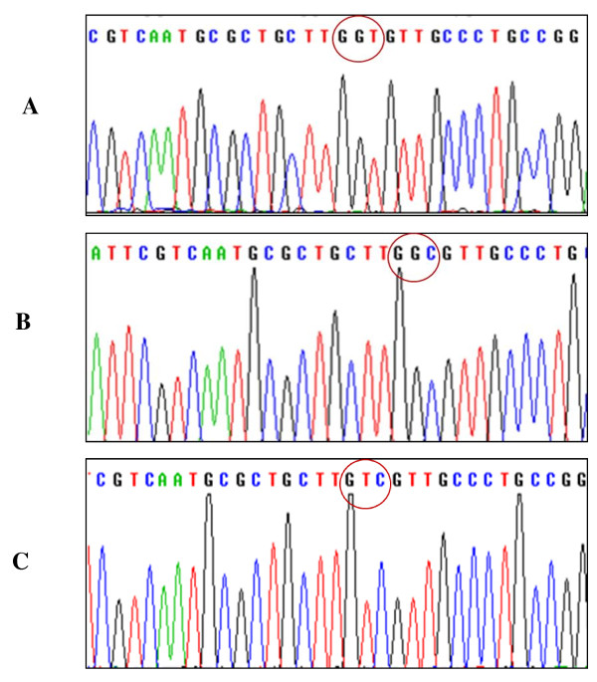
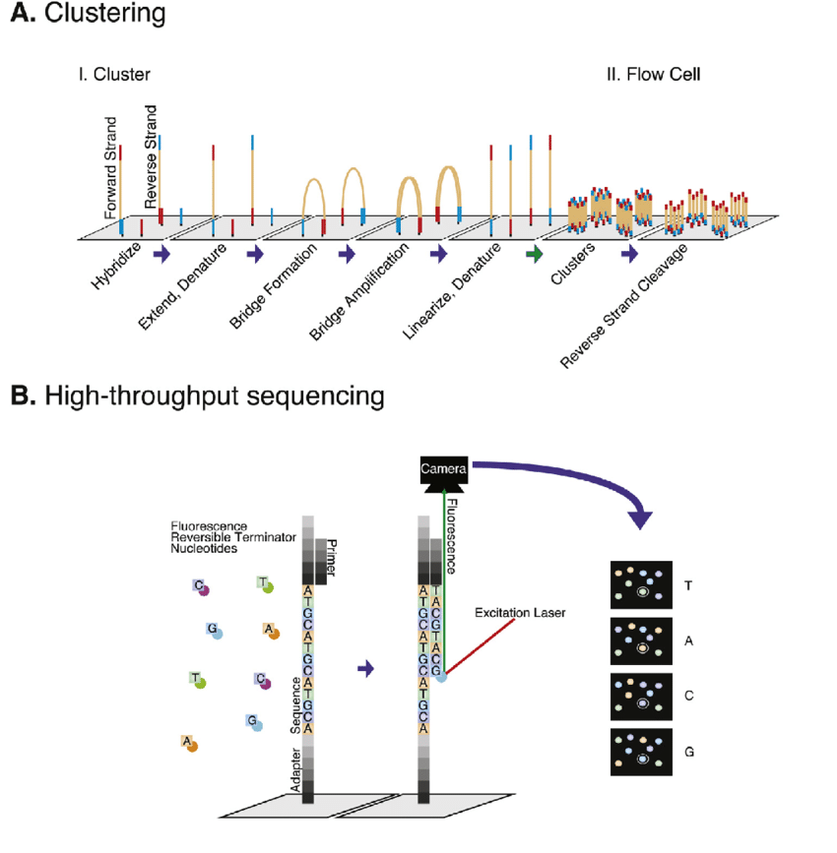
How to extract valuable insights?
Raw data
Pre-processing and quality analysis
Alignment / mapping
Structural Variants
Analysis
Report

Slide 16
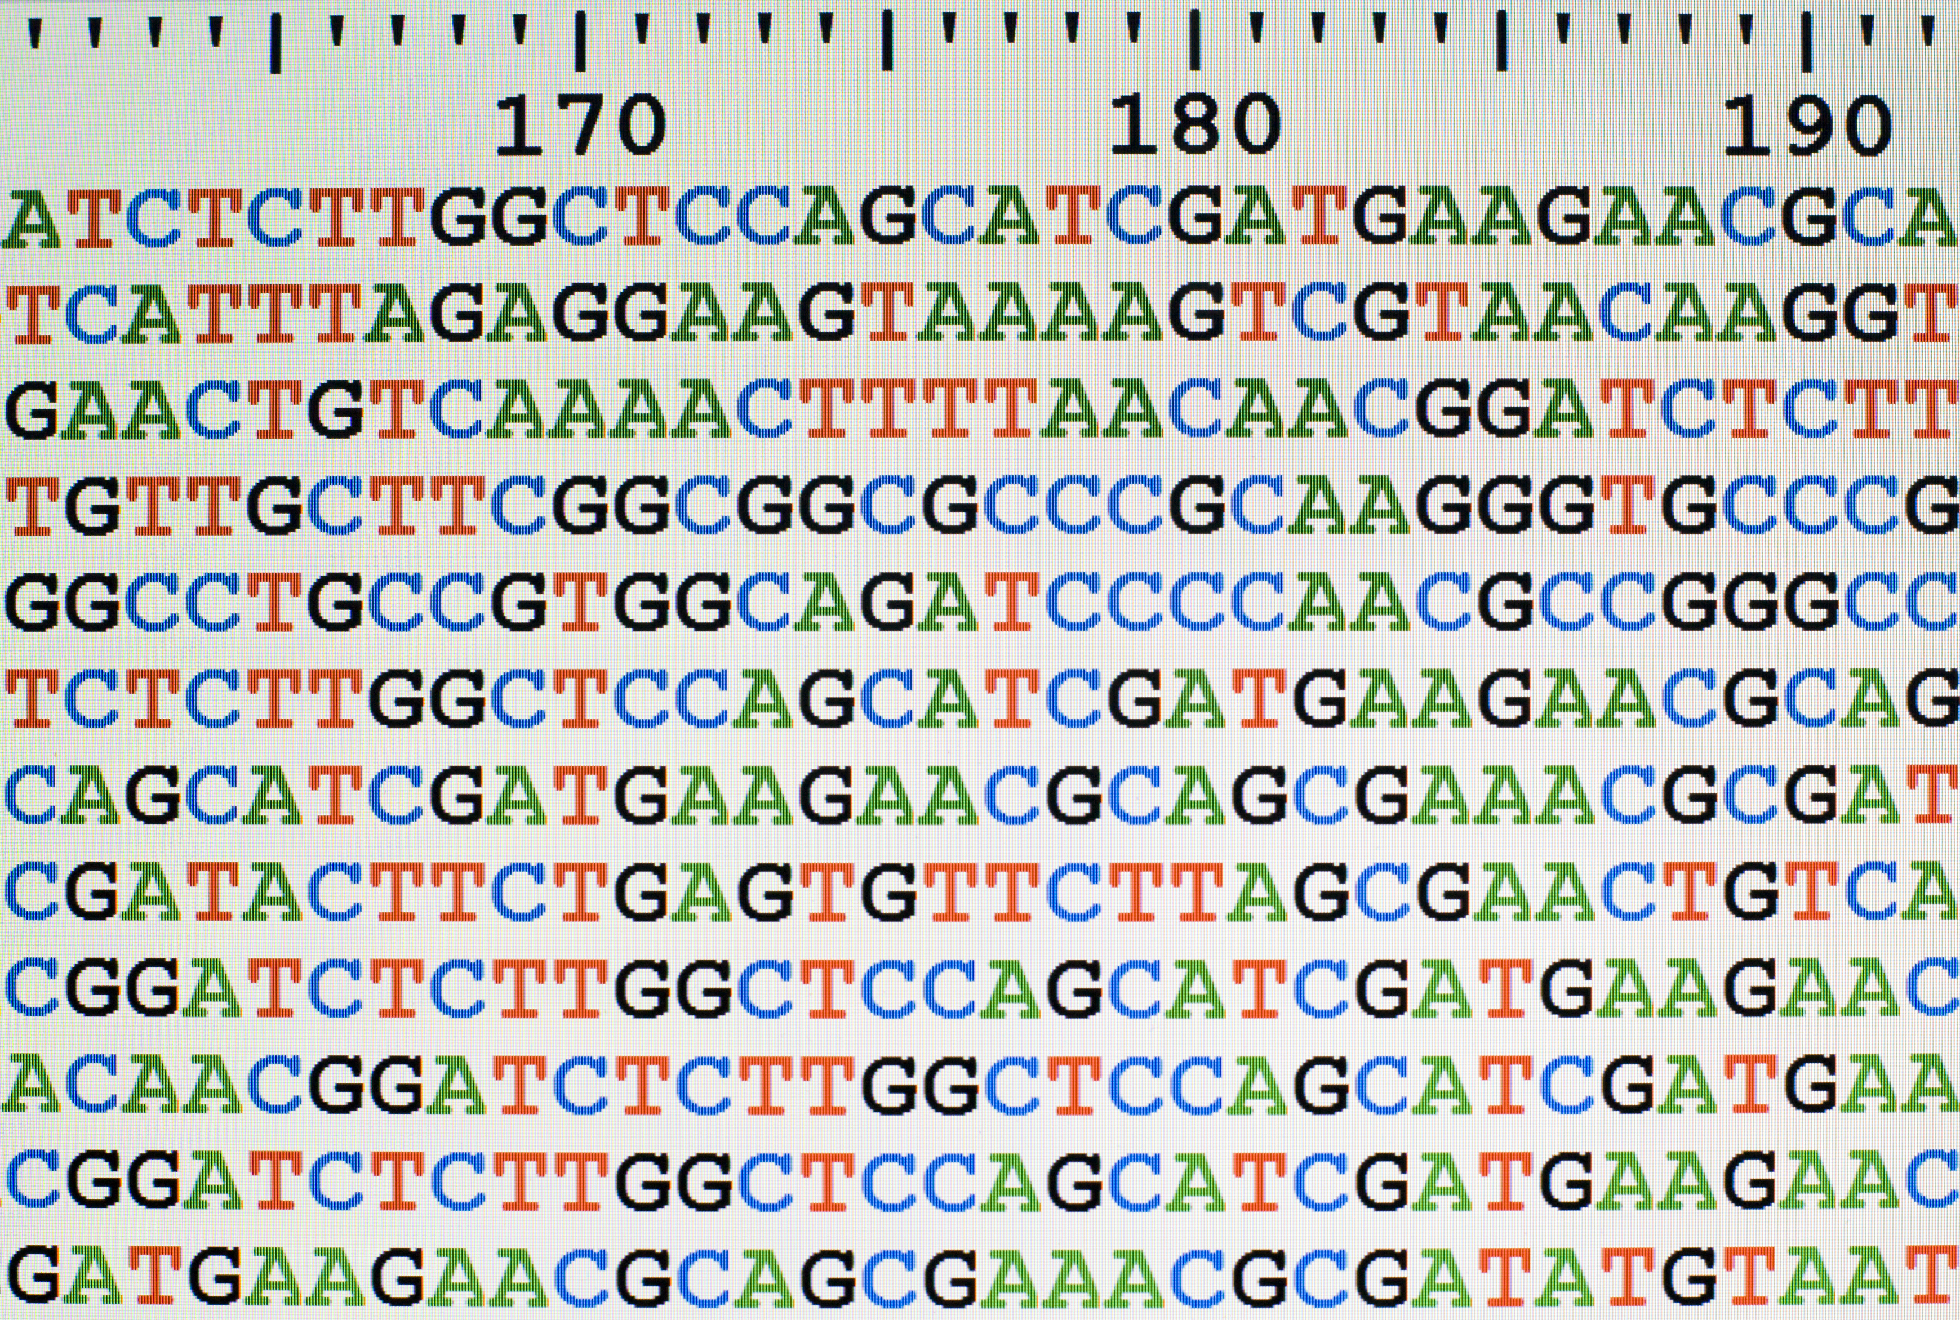
How to extract valuable insights?
Raw data
Pre-processing and quality analysis
Alignment / mapping
Structural Variants
Analysis
Report

Slide 17
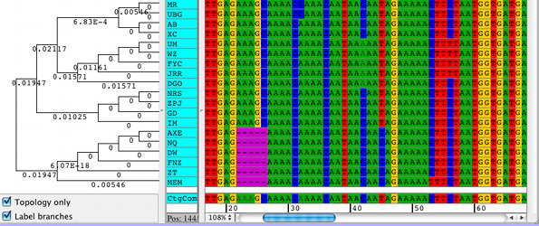
How to extract valuable insights?
Raw data
Pre-processing and quality analysis
Alignment / mapping
Structural Variants
Analysis
Report

Slide 18
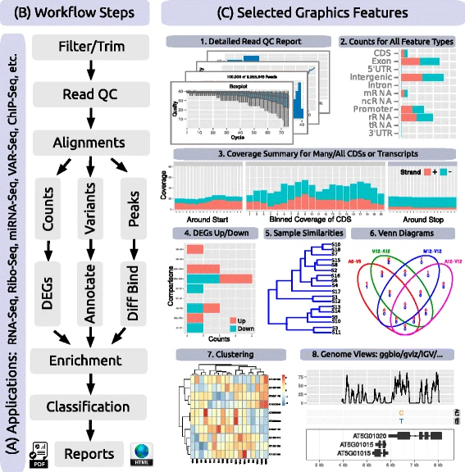
Data Viz
Raw data
Pre-processing and quality analysis
Alignment / mapping
Structural Variants
Analysis
Report

Slide 19
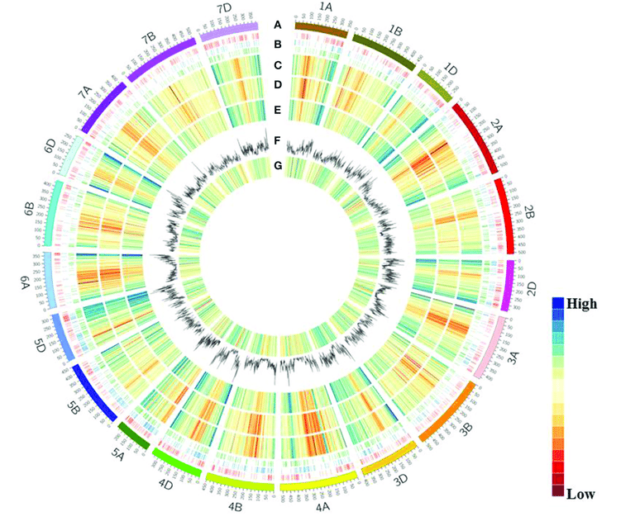
Data Viz
Raw data
Pre-processing and quality analysis
Alignment / mapping
Structural Variants
Analysis
Report

Slide 20
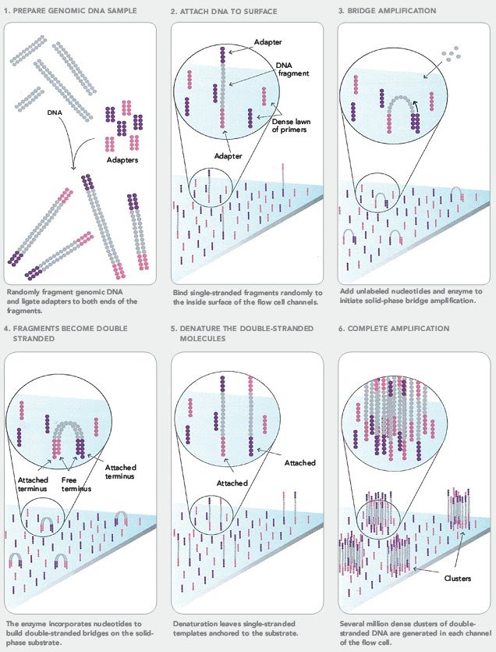
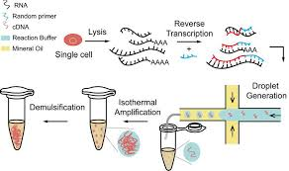
Why genomics?
Genomics is the most exciting field in bioinformatics
New technologies allow high throughput
Single Cell

Slide 21
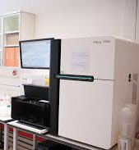
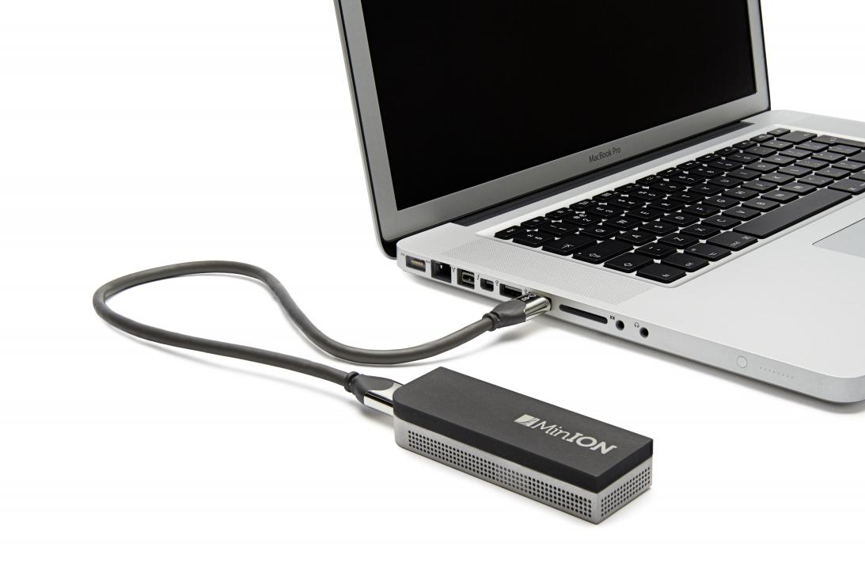
Why genomics?
Genomics is the most exciting field in bioinformatics
“Small” equipment
Cost reduction

Slide 22
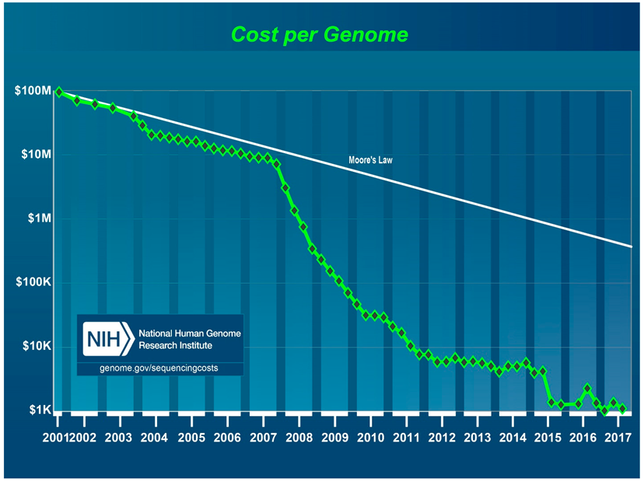
Why genomics?
Projects took years
Big teams/consortiums
Small team can “easly” produce terabytes of data

Slide 23
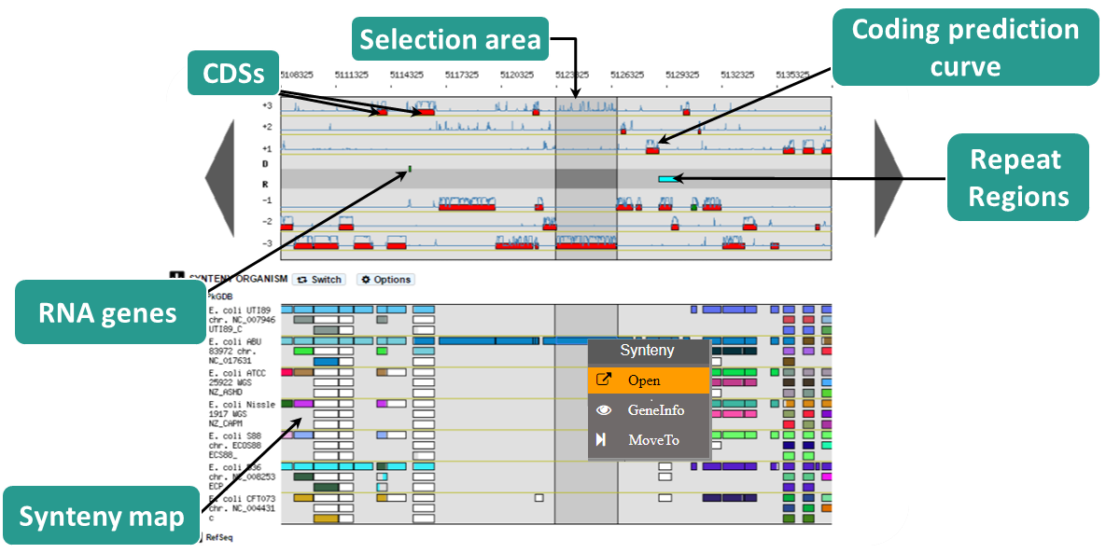
Why genomics?
WE HAVE
LABELS!!!

Slide 24
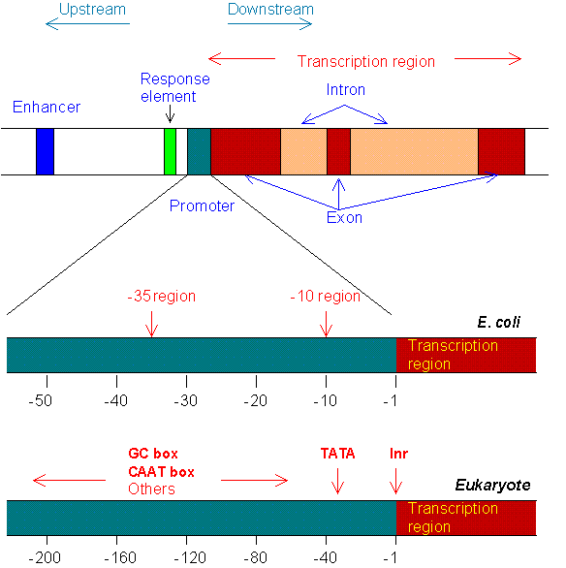
Why genomics?
WE HAVE
LABELS!!!
Coding regions and
non-coding regions
Promoting and enhancing regions
Other signals

Slide 25
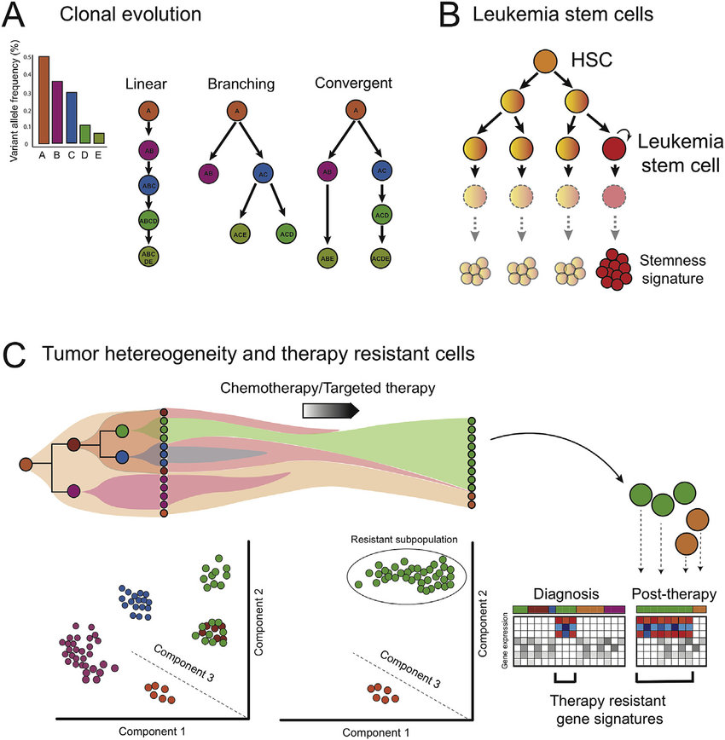
What output can we provide?
Health applications
Disease diagnostic
Prenatal diagnostic
Paternity test
Public health studies

Slide 26
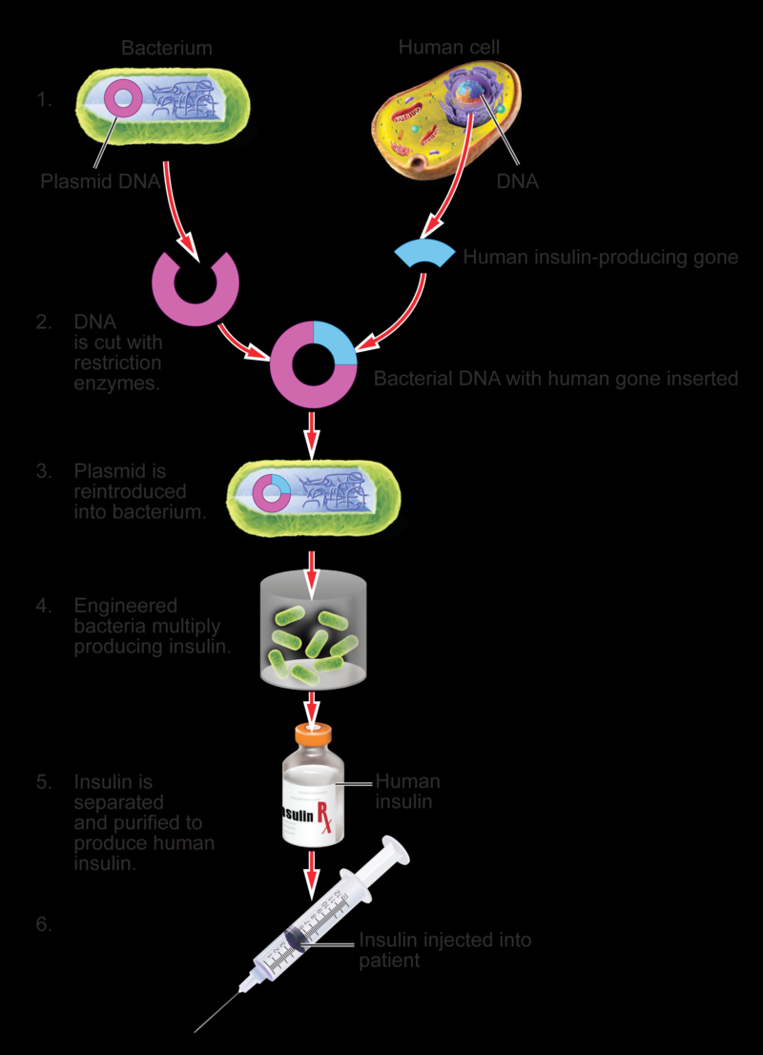
What output can we provide?
Biotech applications
Medicine development
Production of molecules in bio-reactors

Slide 27
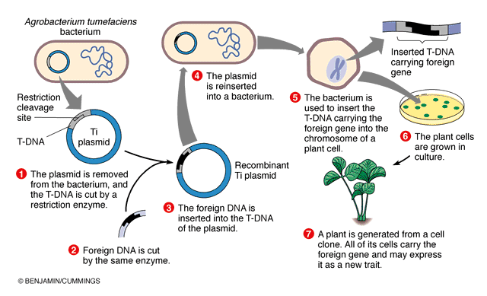
What output can we provide?
Biotech applications
Medicine development
Production of molecules in bio-reactors
Crop improvements

Slide 28
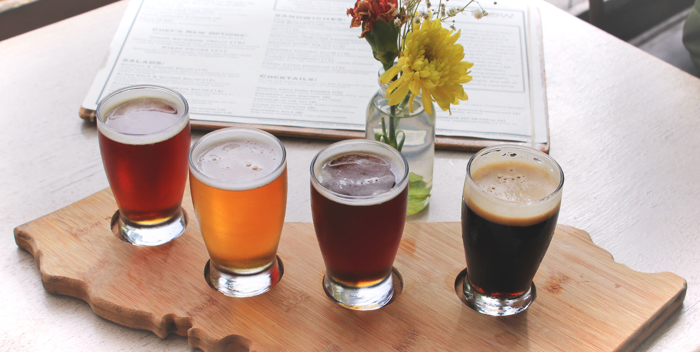
What output can we provide?
Biotech applications
Medicine development
Production of molecules in bio-reactors
Crop improvements
Improve Beer Production

Slide 29
Types of challenges
Comparative Genomics
Protein Expression
Genome Assembly
Pan Genomics
Evolutionary Biology
Molecular Networks
SNP call
Gene Expression
Genome Annotation
(Multi-layer) Image analysis
Gene Regulation
Cellular Organization
Systems Biology
Genetics Disease
Literature analysis
Protein Localization

Slide 30

What is a genome assembly?
Sentences are continuous
Only 4 letters
Repeated paragraphs
Inverted sentences
Many typos
The most amazing
and
“unreadble” book

Slide 31
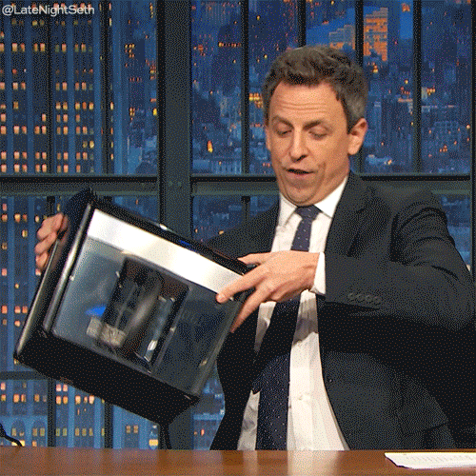
What is a genome assembly?
Millions of fragments
Short reads ~400bp (20 -30k bp)
4 letter code
Random
Unique/multiple sources

Slide 32
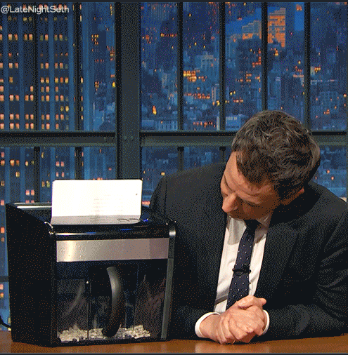
What is a genome assembly?
Millions of fragments
Short reads ~400bp (20 -30k bp)
4 letter code
Random
Unique/multiple sources

Slide 33
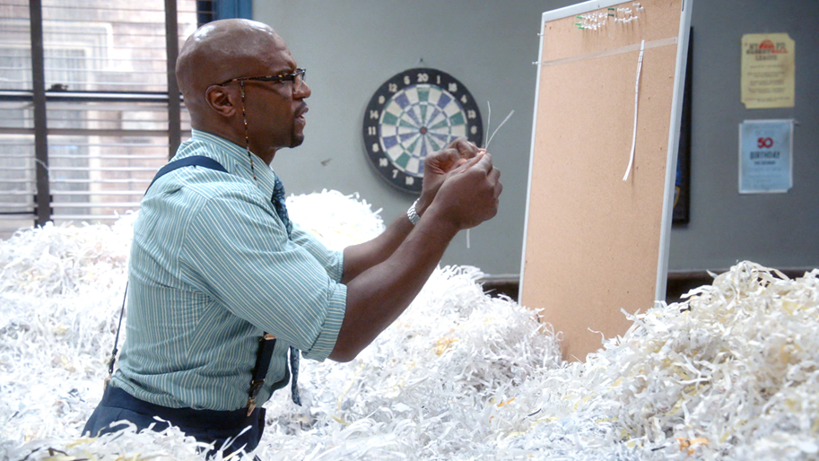
What is a genome assembly?
Recreate long reads from fragments
Naïve approach
Greedy approach
Overlap Layout Consensus
de Bruijn graphs

Slide 34
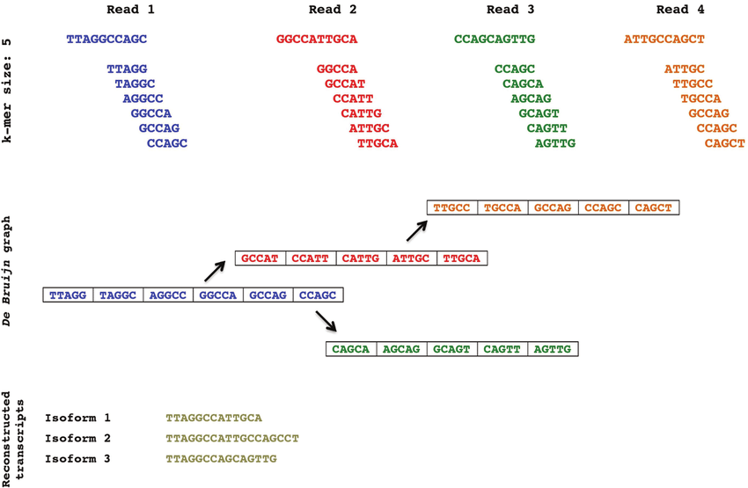
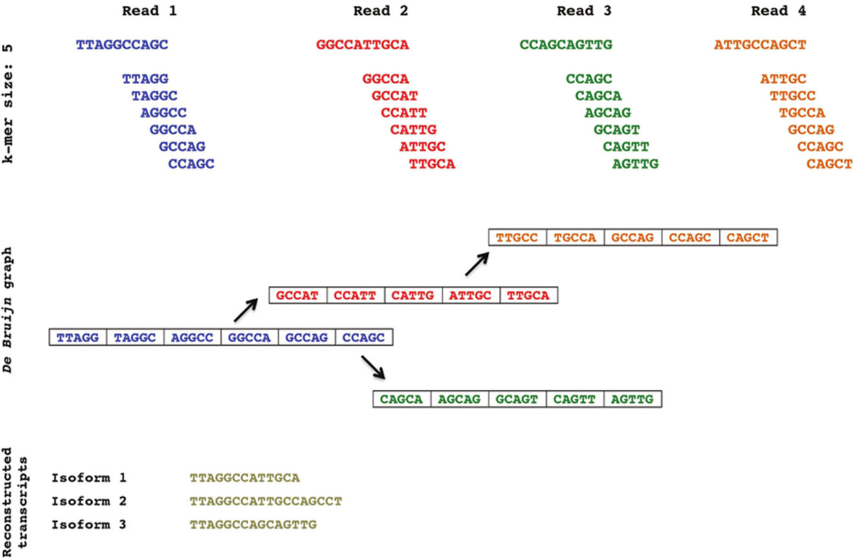
What is a genome assembly?
k-mer

Slide 35
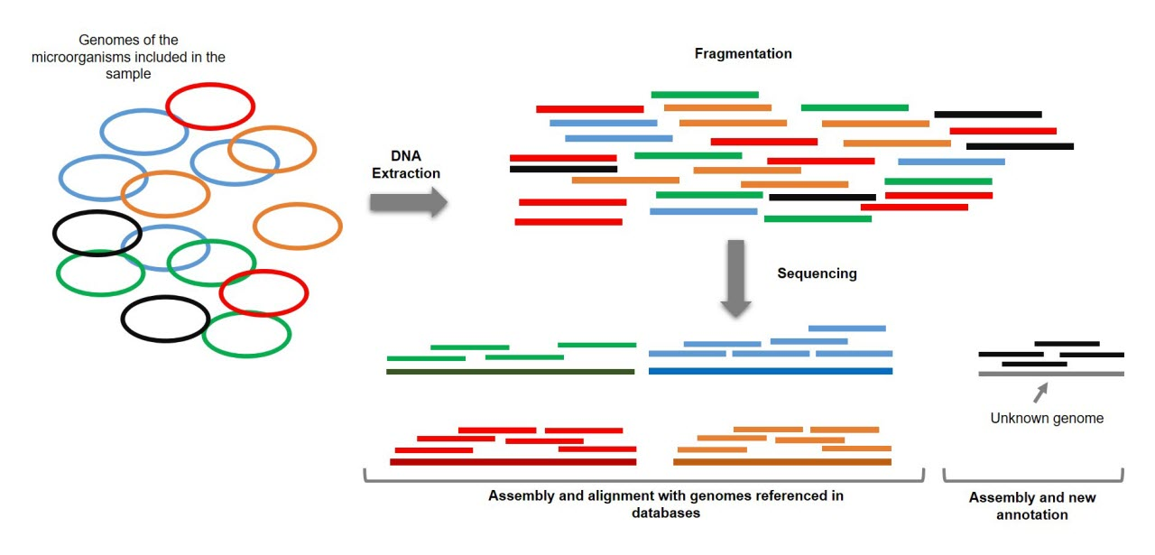
What is a genome assembly?

Slide 36
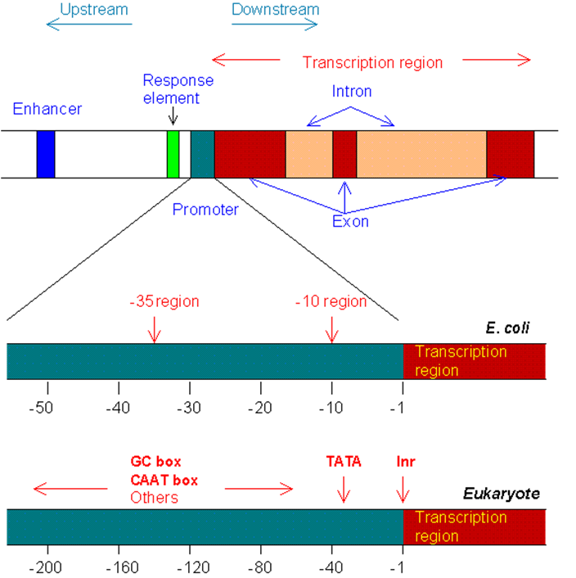
ML/DL for Biology
Gene regulation is highly complex
Labels from many different cells, tissues, organisms or populations
Discover new regions/mechanisms for gene regulation

Slide 37
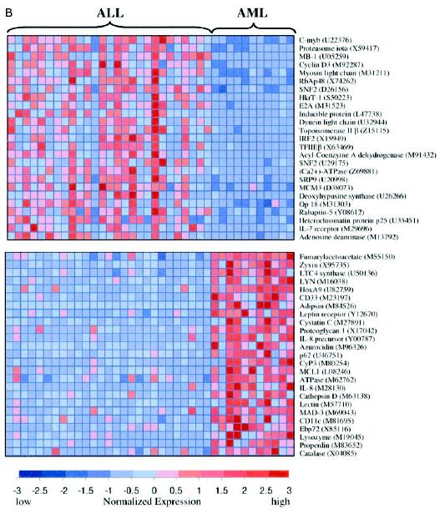
ML/DL for Biology
Population 1
Population 2
Gene differential expression
Transcriptomics
Integrate with genomics
Discover new regions/mechanisms for gene regulation

Slide 38
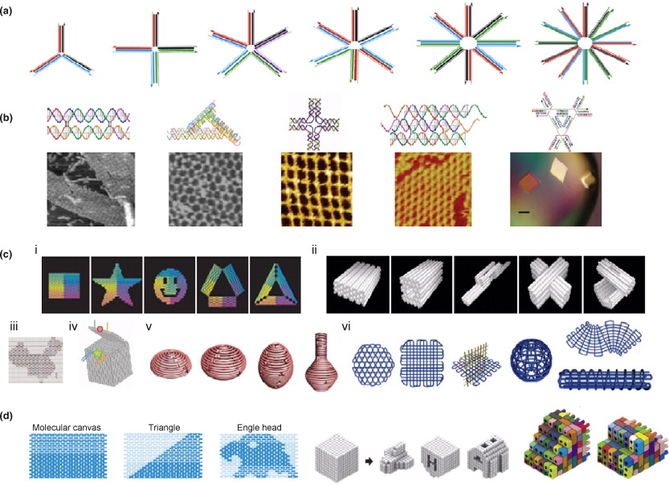
DNA computing
Build nanotubes with DNA
Build small structures with DNA nanotubes
Awesome properties

Slide 39
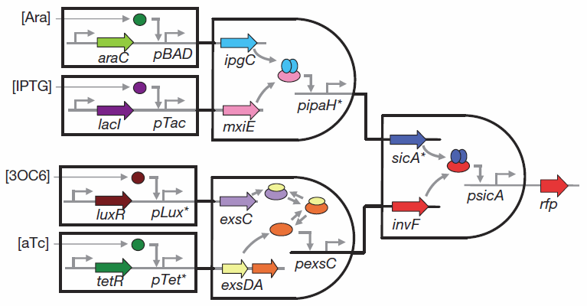
DNA computing
Build logical circuits

Slide 40
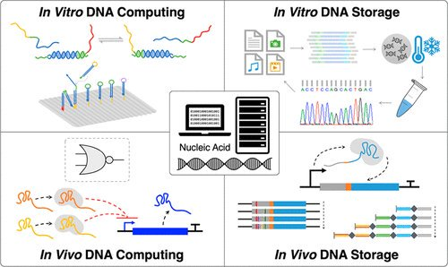
DNA computing
Build logical circuits
Build DNA Robots

Slide 41
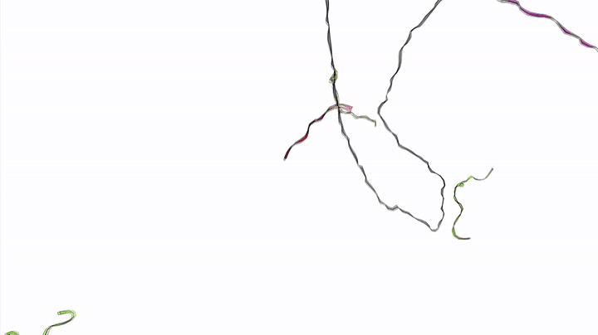
DNA computing
Build logical circuits
Build DNA Robots

Slide 42
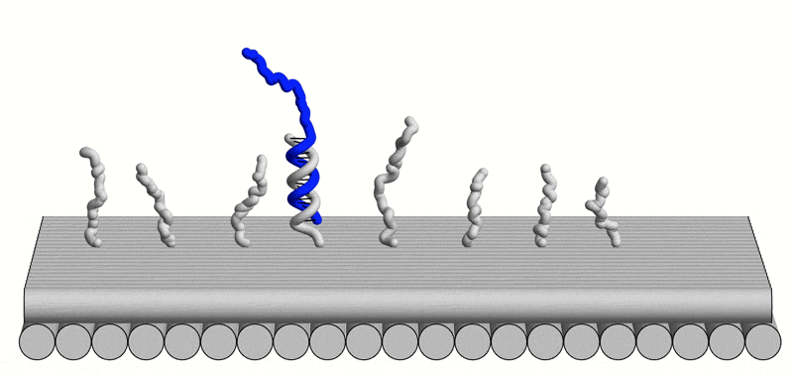
DNA computing
Build logical circuits
Build DNA Robots

Slide 43
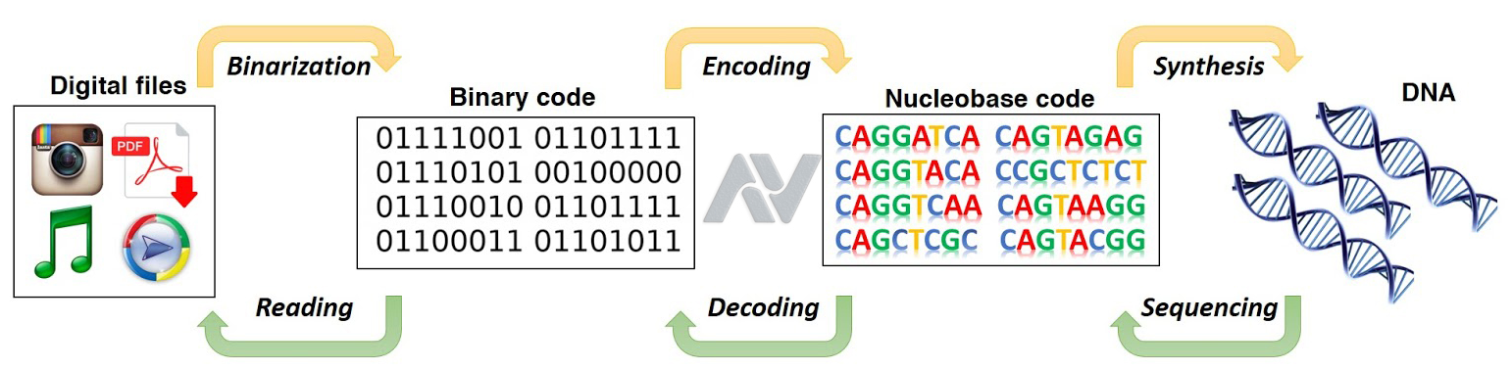
DNA computing
Build logical circuits
Build DNA Robots
Storage information

Slide 44
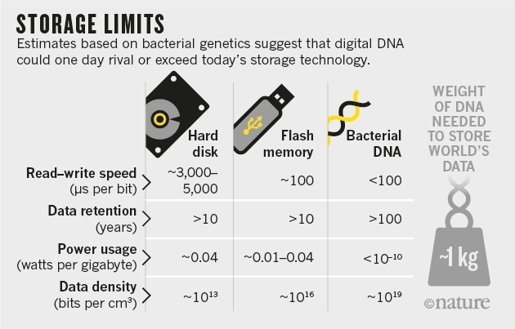
DNA computing
Build logical circuits
Build DNA Robots
Storage information

Slide 45
Recap
Mendel
Discovery of DNA
Synthesis of DNA
Read DNA
Analyse DNA
High-throughtput Sequencing
Bioinformatics / Statistical models
Big data
ML/DL
???

Slide 46



Thank you!
I also would like to thank
Herlander Azevedo
Miguel Carneiro
Tom Gilbert

